Slide 1

2026 Business Office Forum
Thursday, September 17, 2026
Saint John’s Catholic Church, Adel
Internal Review Topics

Slide 2
Topics for Discussion
FY2026 Annual Financial Report (AFR) Process
Annual Diocesan Appeal
Volunteer Policy and Procedure
Risk Management Metrics

Slide 3
AFR FY2026: Instructions and Checklist Items
Annual Financial Report for period encompassing 7/1/2025 through 6/30/2026 is due end of day
September 30, 2026.
Canon Law:
  Canon Law 1287 Section 1: Mandates that administrators present an annual report of parish goods and finances to the diocesan bishop (via diocesan finance officer or committee).
  Canon Law 1287 Section 2: Stipulates that administrators must “rendor an account to the faithful concerning the goods offered by the faithful to the church”. Frequently via publishing of annual statement in the parish bulletin or printed report to the community.
All year-end entries should be posted and reconciled.
Complete the AFR survey ONLINE. Assistance: Jessica Holcomb at jholcomb@dmdiocese.org.
Items that should already be presented to your Pastor and Finance Council.
  Statement of Financial Position.
  Statement of Dedicated Accounts.
  Statement of Activities including the Annual Budget for the FY2025-26.
  Copy of completed AFR.
  Proposed AFR to be shared with parish/student families.
And the Finance Council meeting every member of that leadership groups and each Trustee must sign the Affirmation signature page, stating they reviewed and approved the AFR and financial statements.
Notes:
5. The four items that should be submitted to the Diocese.

Slide 4
AFR FY2026: Instructions and Checklist Items (continued)
6. Submit to the Diocese:
  Annual Financial Report (AFR) for previous fiscal year.
  Survey
  AFR Affirmation Signature Page.
  Contact Information Sheet.
AFR must be posted or otherwise made available to all parishioners. You must provide Parishioners/ stakeholders a copy upon request. Additional distribution suggestions:
  Electronically or by mail.
  Attaching in the bulletin.
Submit to the Diocese as presented to parish/student families/stakeholders.
The AFR acts as an internal controls document that verifies fiscal compliance to the best of your knowledge.
Current progress: Annual Financial Report: 19
Survey: 45
AFR Affirmation Signature Page: 21
Contact Information Sheet: 23
FY2026 AFR Process Complete: 17
TOTAL Entities: 86
Notes:
Current Progress: only 11 out of 80+ Parishes and Schools.

Slide 5
Annual Diocesan Appeal
We start calculating ADA by Parish: October 1, 2026.
ADA Calculation Review Committee will meet this fall to discuss any proposed changes. So if you have any changes please contact Laura Hofstrad.
Parishes must finalize and submit their year-end financial data by the designated deadline to ensure accurate calculation of the upcoming Annual Diocesan Appeal (ADA) goals.
ParishSOFT shows 7 parishes with books still open in FY2025-26.
Be mindful of all adjustments made by the Diocese on your ADA last year, so you don’t repeat in the current year. This means accurate placement and disclosure of:
  Primary Income.
  Auxilliary Income.
  Deductible Auxilliary Expenses/Religious Expenses/School Expenses (if applicable).
Notes:
If you have questions on adjustments make last year, please reach out to me.

Slide 6
Volunteers: Building and Grounds / Parish and School Volunteers
Volunteers are essential for many of our parishes, schools, and other church organizations to provide basic services that are counted on by our families.
Reference - Parish and School Resource Manual:
Section 306.5 Volunteer Accident Coverage (page 52).
Section 804.3 Statement on the Use of Volunteers for Buildings and Grounds including acceptable/non-acceptable work, tools and protection equipment requirements (pages 122-123).
Building and Grounds:
Includes services that would normally require someone to be certified, licensed, bonded and/or insured if required when hiring a contractor for such work.
Volunteers should sign a Buildings and Grounds Volunteer Worker Agreement which acknowledges:
  Volunteer will engage in activities for which they have requisite knowledge.
  Volunteer is in good health.
  Volunteer understands they have no authority to represent the Parish/School/Diocese in dealing with any person/business/firm and will not attempt to act as the contracting agent.
  Volunteer is not entitled to any wages/reimbursements/ benefits from the volunteer work.
  Volunteer agrees to indemnify and hold harmless the parish/school and the Diocese for any claim, liability, or expense arising from any contractual liability incurred or alleged to have incurred.
Notes:
Buildings and Grounds – beyond simple cleaning and yard work; like working with equipment that can cause harm such as lawn mowers.
1. With a service requiring this, they should provide the same credentials and proof of insurance even in volunteering.
(2.) Building and Grounds Volunteer Working agreement is on page 181 of the Parish and School Resource Manual;
(2) (b) In particular that they agree not to perform any activity that they feel is unsafe.
(2) (d) including worker’s compensation, unemployment benefits, medical and overtime.

Slide 7
Volunteers: Building and Grounds / Parish and School Volunteers (continued)
  Volunteer agrees to indemnify and hold harmless the parish/school and the Diocese for any claim, liability, or expense arising from any contractual liability incurred or alleged to have incurred.
  Volunteer realizes that they could be injured in the performance of their volunteer duties and that they will need to first submit all medical claims too their own insurance provider before submitting any unpaid medical costs through Parish/School/Diocese Volunteer Accident policy.
  Any unpaid medical bills resulting from an accident after the above, volunteer agrees to be responsible for any remaining payments and releases Parish/School/Diocese.
Notes:
(g) Releases from all claims, demands or causes of action arising therefrom;

Slide 8
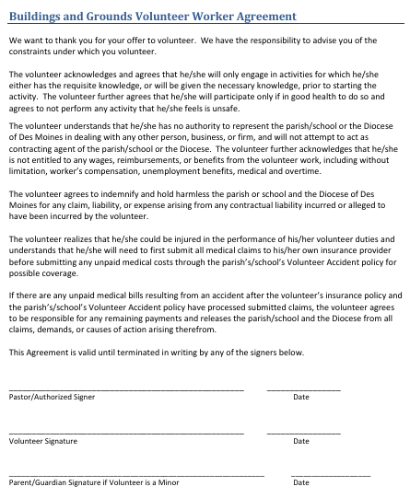
Volunteers: Building and Grounds / Parish and School Volunteers (continued)
Notes:
Many of the form related to Volunteers can be found in the Parish and School Resource Manual, beginning with the Workers Agreement outlining what we just discussed found on page 181 of the manual.

Slide 9
Volunteers: Building and Grounds / Parish and School Volunteers (continued)
Acceptable vs. Non-Acceptable Work by age class:
Ages 10-14 (with adult supervision):
  Acceptable work: Simple cleaning operations such as mopping and sweeping; light yard work; serving food at designated food distribution sites.
  Non-Acceptable work: use of ladders/scaffolding; handling toxic material; use of power saws or other woodworking machines; operation of snow blowers or lawn mowers; structural demolition; excavation work; operation of motor vehicles; no tree trimming; roofing operations.
Ages 15-17 (with adult supervision):
  Acceptable work: same as 10-14 plus simple construction jobs such as drywall or laying floors, tiles, carpets.
  Non-Acceptable work: same as 10-14.
Acceptable vs. Non-Acceptable Work by age class:
Ages 18-20:
  Acceptable work: Same as 15-17 plus more advanced demolition and construction projects.
  Non-Acceptable work: use of ladders/scaffolding over 12 feet; handling toxic material; use of power saws or other woodworking machines unless properly trained; operation of snow blowers or lawn mowers unless properly trained; structural demolition; tree climbing to trim branches; roofing operations; hot work (torches, welding, grinding).

Slide 10
Volunteers: Building and Grounds / Parish and School Volunteers (continued)
Acceptable vs. Non-Acceptable Work by age class:
Ages 21 and older:
  Acceptable work: all jobs typically expected of volunteer workers and appropriate to their skillset.
  Non-Acceptable work: use of ladders/scaffolding over 12 feet unless properly trained; use of power saws or other woodworking machines unless properly trained; operation of snow blowers or lawn mowers unless properly trained; structural demolition; tree climbing to trim branches; roofing operations; hot work (torches, welding, grinding).
Volunteer Accident Coverage: Coverage is available for all volunteers should they be hurt while performing requested duties for a Parish/School. This coverage provided is “excess” coverage which means the volunteer’s own insurance would be primary.

Slide 11
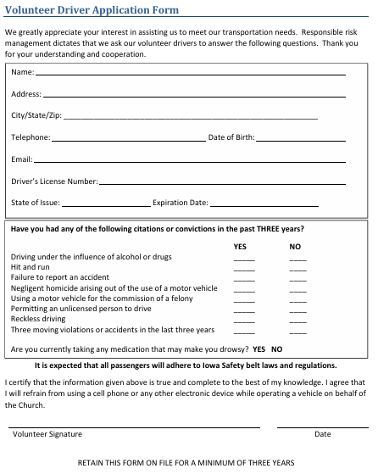
Volunteers: Building and Grounds / Parish and School Volunteers (continued)
Notes:
Also related to our discussion on Drivers last time we met, here are the documents provided For Volunteers driving on Parish Business have them fill out, on page 184 of the Parish and School Resource Manual, a drivers application form giving us all their pertinent information.

Slide 12
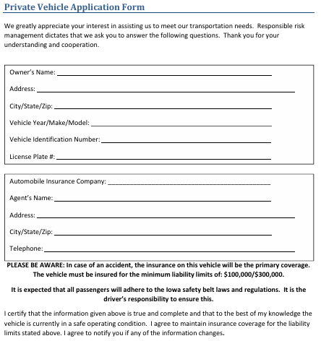
Volunteers: Building and Grounds / Parish and School Volunteers (continued)
Notes:
Also, Form you should have on car information for each employee and volunteer who drives for you, on page 185 of the Parish and School Resource Manual

Slide 13
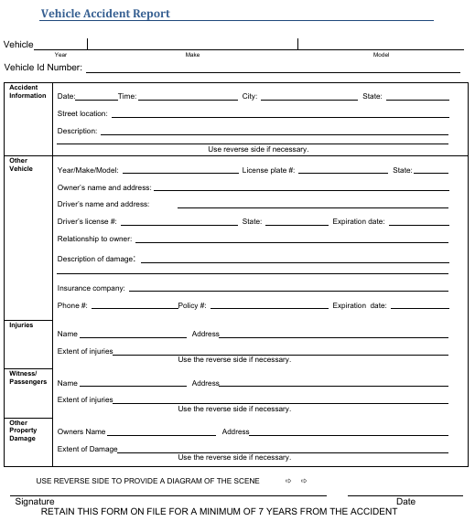
Volunteers: Building and Grounds / Parish and School Volunteers (continued)
Notes:
Form you should have to document any vehicle accidents to employee or volunteers driving on parish/school business, on page 186 of the Parish and School Resource Manual

Slide 14
Volunteers: Building and Grounds / Parish and School Volunteers (continued)
Volunteers in Schools – Legal and Safety Requirements:
Child Protection and Screening:
  Complete all required Diocesan Safe Environment Training and Screenings.
  Background checks must be completed every five years per VIRTUS requirements.
  All must be complete and approved before any contact with students.
Mandatory reporting training if direct contact with students; Iowa mandatory child abuse reporting requirements; school code of conduct.
Student Safety & Supervision: Volunteers such as mentors interactions occur in open visible areas of the school; within sight of staff or other students; prohibits one-on-one meetings behind closed doors.
Volunteer Status: clearly defined as being unpaid and not employment relationship.
Volunteer Agreement: Mentor signs a Volunteer agreement acknowledging all these items.
Mission & Conduct Expectations:
  Support the Catholic mission and values of the school.
  Model Christian leadership, integrity, and appropriate boundaries.
  Follow all Diocesan and school policies.
Notes:
(1.) (a) which includes checking criminal history background; the sex offender registry; etc.
(1.) (c) VIRTUS Requirements certification includes background screening, code of conduct review, and recertification every five years.
(3.) And assigns a designated school employee to supervise.
(4.) and the school reserves the right to end the volunteer participation at any time.

Slide 15
Volunteers: Building and Grounds / Parish and School Volunteers (continued)
Volunteers in Schools – Legal and Safety Requirements:
7. Risk Management & Liability: Diocesan/Parish/School insurance coverage extends to volunteer mentors.
8. Program Oversight:
  Assign a school employee supervisor.
  Establish clear communication and accountability procedures.
  Maintain documentation of all required training, background checks, and signed agreements.
Notes:
(1.) (a) which includes checking criminal history background; the sex offender registry; etc.
(1.) (c) VIRTUS Requirements certification includes background screening, code of conduct review, and recertification every five years.
(3.) And assigns a designated school employee to supervise.
(4.) and the school reserves the right to end the volunteer participation at any time.

Slide 16
Volunteers: Building and Grounds / Parish and School Volunteers (continued)
When is it a Non-Parish Sponsored Event:
Boy Scouts/Girl Scouts/Knights of Columbus other similar organizations that use parish facilities for meetings and fundraisers.
AAU sport teams and non-parish sponsored sport classes or clinics.
Parishioner and non-parishioner families that rent or use facilities for family events or other activities.
Any other organization, municipality, city or county organization that uses parish facilities for functions.
Exclusions to Coverage:
Any type of carnival event.
Fireworks and firework displays.
Events involving: BYOB; pool and lake activities; recreational vehicles; organized or operated by professional promotors or performers.
Non-religious musical performances or concerts.
Organized sporting events including tournaments and camps.
Events where a fee or admission is charged unless all proceeds go to a charity.
Political rallies.
Amusement rides, including mechanically operated devices, trampolines and rebounding devices.
Claims related to an epidemic/pandemic.
Notes:
(4.) Such as elections.
Exclusions of Coverage: if you decide to go forward with you should have some sort of consent and liability waiver or general liability insurance naming the parish/school and the Diocese as additional insureds should be required

Slide 17
Catholic Diocese of Des Moines - Risk Management
The Diocese Finance Council’s Risk Management subcommittee is always looking for ways to better manage risk not only from Diocesan perspective, but parish to parish and school to school.
Creation of overall Risk Matrix for the Diocese of Des Moines that identifies:
  29 risks including risks related to every operational facets of our diocese, parishes, and schools.
  Identifies ownership of each risk.
  Matched with appropriate mitigation strategies and action plans
  And includes identification of additional resources to help mitigate the risks.
Using this Risk Matrix as our base, we can identify each entities strengths and weaknesses using risk metrics to score them with the goal to improve operational effectiveness.
Risk Assessment Program: Goal is to change behaviors with an equitable scoring program that systematically identifies, evaluates, and prioritizes potential threats to an organization's objectives so that effective controls and mitigation strategies can be implemented:
  Early stages of creation.
  Objective: Protect people and assets.
  Objective: Prioritize resource allocation.
  Objective: Reward good behavior.

Slide 18

Risk Metrics: Key Risk Indicators
Key Risk Indicators (KRI) is a tool to highlight things that can potentially go wrong and cornerstone of our proposed risk assessment program.
Determining relevant KRI’s:
  Operational
  Security
  Financial
  Compliance
  Strategic
Benefits of tracking KRIs:
Proactive Risk Mitigation.
Informed Decision Making.
Regulatory Compliance.
Notes:
Proactive Risk Mitigation: (1.) helps you Identify and Understand your Risks; (2.) so that you are More likely to detect threats earlier; (3.) Proactively measures risks before they escalate.
Informed Decision Making: (1.) Help make better and faster decisions; (2.) Allocation of resources; (3.) Prioritize risk management efforts.
Regulatory Compliance: More formal approach can help with regulatory compliance.

Slide 19
Risk Metrics: Proposed Risk Assessments for Parishes and Schools
Our Areas of Focus:
  Internal Controls
  IT Controls
  Compliance Reporting
  Governance
  Accounting/Financial Reporting
  Facilities
  Safety & Security
  Human Resources
Assessment Timing: Any area of focus could be done annually.
  Annually
  and/or
  Periodically with Internal Reviews
Risk Metric Scoring: We are in the early stages of how we want to score the diocese/parish/school based on these areas of focus, so more to come.
Notes:
Annual assessments include IT, Safety and Security, and HR related surveys we send out annually. Internal Reviews are done every 3-5 years but are much more in depth.
Remember this is proposed not yet implemented.

Slide 20
Questions?
Contact Information: Scott Smyth
Internal Control Analyst
Catholic Diocese of Des Moines
601 Grand Avenue
Des Moines, Iowa 50309
(515) 237-5087
ssmyth@dmdiocese.org

Slide 21
Risk Metrics: Key Risk Indicators
Action Plan for KRI Breaches and how we address issues promptly and effectively:
Have a clear Escalation Path:
  Who Needs to know?
  How should we communicate?
  When should we act?
  Severity of the breach and how critical of an issue = level of urgency and higher level of management exposure.
Analyze Root Causes:
  Gathering data pertinent to the breach.
  Reviewing processes.
  Identifying potential vulnerabilities or weaknesses in our risk management practice.
Establish Mitigation Strategies:
  Minimize event from happening again.
  Strengthen our risk management framework.

Slide 22
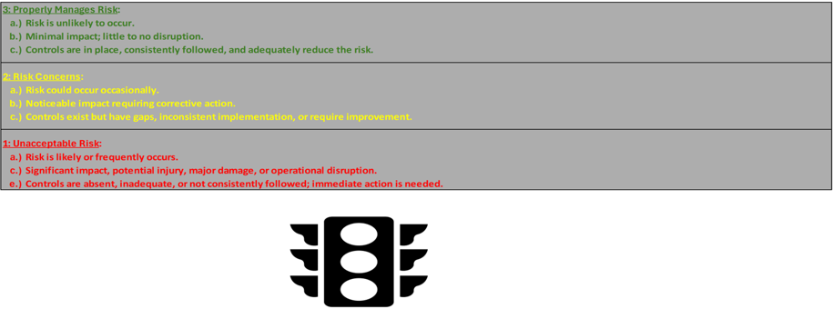
Risk Metrics: Scorecard with Proposed 3-Point Scale Control Ratings
Scorecard will also include:
  Checkmark if control is performed annually or as a part of the internal review process (3-5 years).
  Some Areas of Focus Scoring 3 or 1 Only (satisfactorily completed or not):
    IT
    Facilities
    Safety and Security
    Human Resources
  References to the Catholic Diocese of Des Moines Risk Matrix.
  One other area of focus is past ADA submissions and the number of adjustments needed.
Notes:
*** Checkmark – example of annual control is Human Resources.
Conclusion - overall score could impact such things as how much your parish will be charged for insurance.

Slide 23
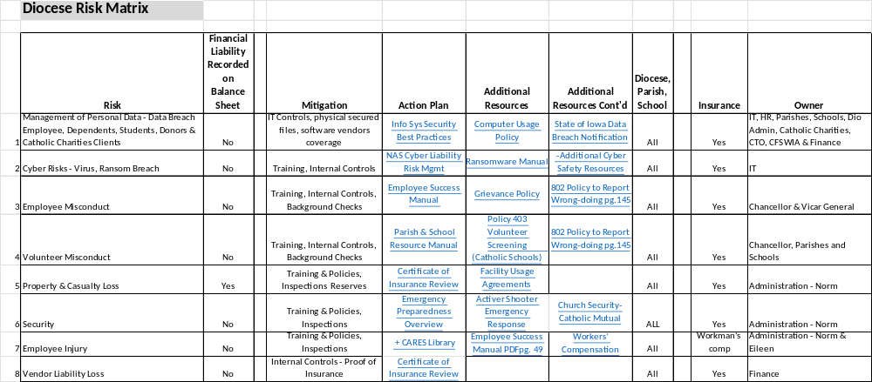
Risk Matrix – Catholic Diocese of Des Moines
Diocesan Risk Management Committee continuously looks at how do we manage risk.

Slide 24
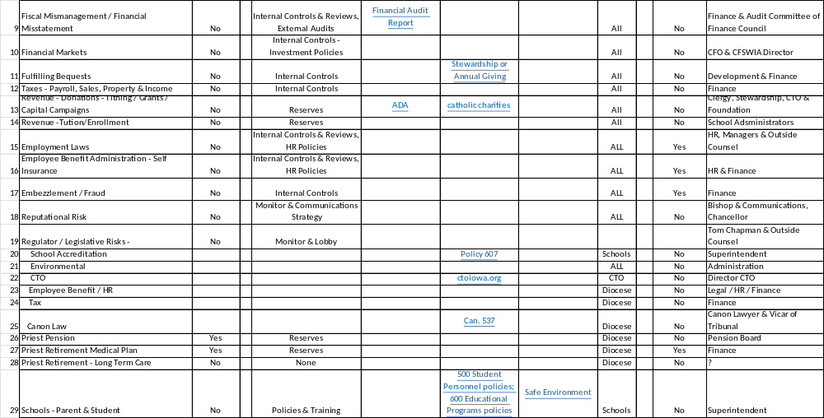
Risk Matrix – Catholic Diocese of Des Moines

